Slide 1
Clocks: Physical and Logical

Slide 2
Why distributed systems need a measurement of time
Schedulers, timeouts, failure detectors, retry timers
Performance measurements, statistics, profiling
Log files & databases: record when an event occurred
Data with time-limited validity,e.g. Cache
Determining order of events across nodes.

Slide 3
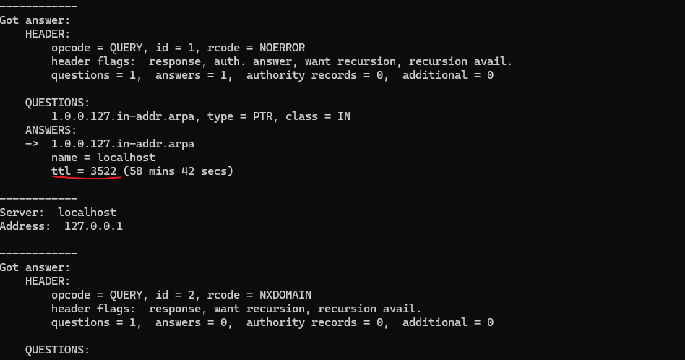
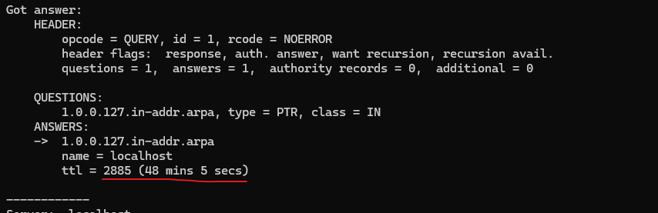
Examples of time data
> nslookup -debug eua.am
ttl(Time to Live) - indicates for how long the response can be cached before it expires.
If you run the same command after a while the ttl will be elapsed.

Slide 4
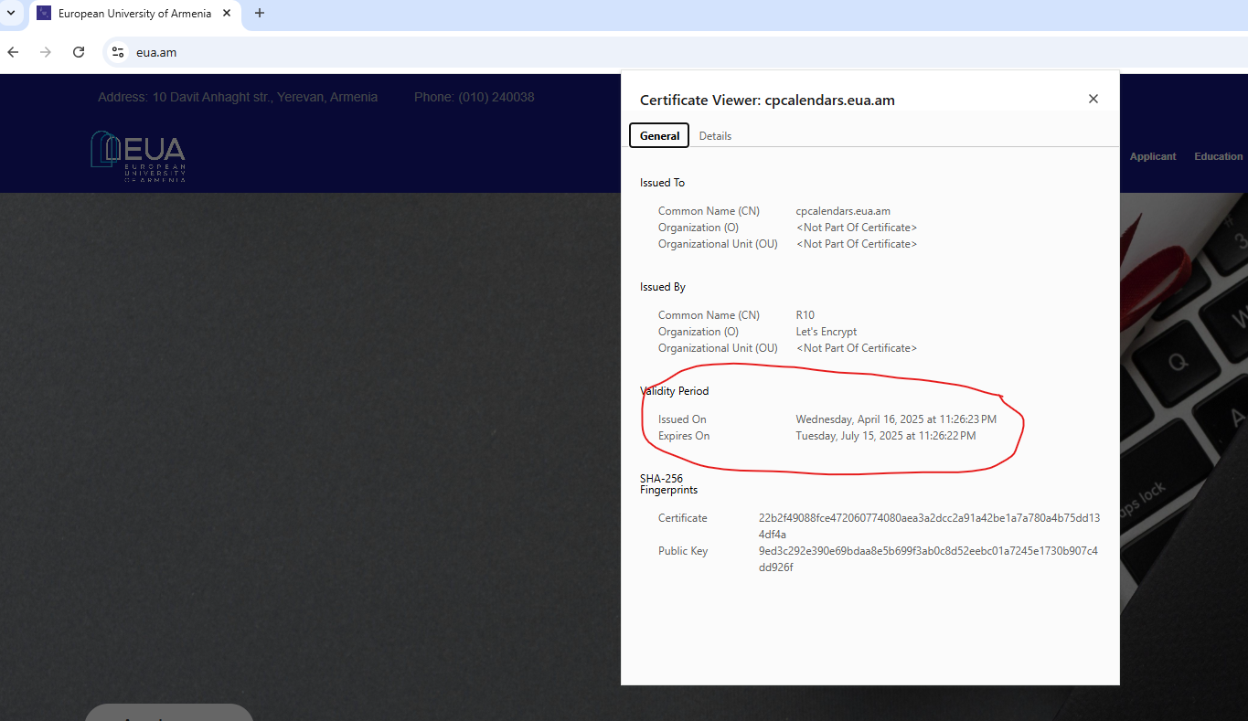
Examples of time data
Certificates for HTTPS connection have a validity period.

Slide 5
Types of clock
Physical Clock - count number of seconds(milliseconds, nanoseconds) elapsed
Logical Clock - count events, e.g., messages sent

Slide 6
Physical Clocks
Highest precision is supported by “Neutral‑strontium‑87 optical lattice clock”: ~ 1 s error in 40 billion yr. Price: ~ 3 M USD
Atomic clocks used in GPS: ~ 1 s error in 2.7 million years. Price: ~ 3-5 K USD.

Slide 7
Time Protocols
 | Precision | Usage
NTP | milliseconds | Computer clocks (Windows/Linux/macOS) Financial trading (sub-millisecond sync) Industrial automation
PTP | nanoseconds | 5G networks (timing alignment) Power grids (phasor measurement) Scientific experiments (particle accelerators)
SNTP | ~100ms | IoT devices Consumer electronics
GPS Time | nanoseconds | Telecom networks (e.g., cell towers) Scientific research.

Slide 8
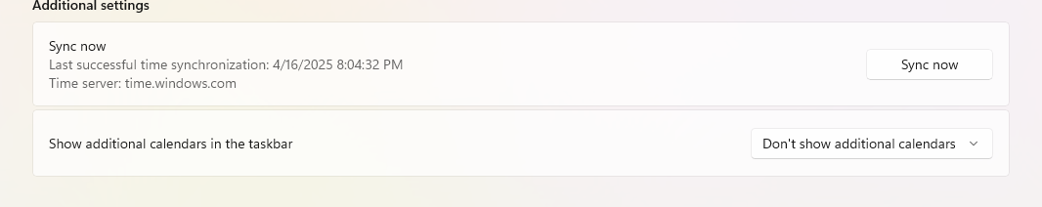
Clock Synchronization
Computers use quartz clock(uses a battery to run even when the computer is off) which has ~ second precision.
Quartz clocks need to be periodically synchronized. For that reason they use NTP or PTP.
The Windows Time service follows the Network Time Protocol (NTP) specification, which requires the use of UDP port 123 for all time synchronization.

Slide 9
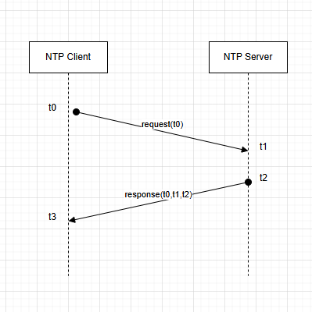
NTP Synchronization
Client sends request with its time: t0
Server takes time t0, and at the moment t2 sends the response, containing t0,t1 and t2
Client calculates the more accurate time by adding network delay(∆/2) calculated below to t2: t= t2 + ∆/2
Round trip delay: ∆ = (t3-t0)-(t2-t1)

Slide 10
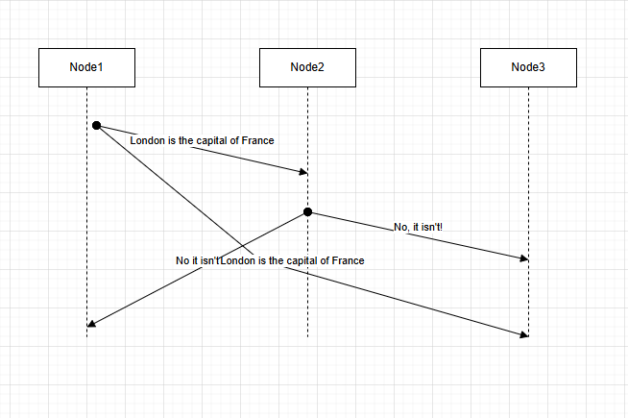
Causality and Happens-Before
Node 1 sends “London is the capital of France” to nodes 2 and 3.
Node 2 receives the message and sends “No, it isn’t!” to other two nodes.
Node 3 receives “No , it isn’t!”, and after a while “London is the capital of France”.

Slide 11
Definition of Happens-Before
a -> b (a happens before be) if and only if:
a and b occurred on the same node and a occurred before b, or
event a is the sending of a message m, and event b is the receipts of that same message m, or
there is an event c, such that a->c and c->b.
Happens-before relationship is a partial order, i.e., it is possible that neither a->b nor b->a. In that case a and b are concurrent(a||b).

Slide 12
Causality
Causality is the relationship between cause(an action) and effect(the outcome).
I answers: “Does X make Y happen?”
Key Rules of Causality:
Temporal Order : The cause must happen before the effect. E.g. Rain(X)->Wet Ground(Y)
Correlation ≠ Causation: Just because two things happen together doesn’t mean one causes the other. E.g., In a famous joke a biologist cuts cockroach’s legs one by one and commands :”Run!”, after cutting the last let the roach can’t move anymore. The biologist makes conclusion: “Cutting all legs makes roaches deaf!” . Correlation without causation: cutting the legs and becoming deaf.
Counterfactual Dependence: Would Y still happen if X didn’t?

Slide 13
Causality and Happens-before relation
When a->b, then a might have caused b
When a||b, a cannot have caused b
Happens-before relation encodes potential causality.

Slide 14
Logical Clocks
A logical clock is a mechanism to assign a partial ordering to events across multiple processes, enabling systems to track causality without relying on synchronized physical clocks. Since distributed systems lack a reliable global clock and communication delayed vary, logical clocks provide a way to reason

Slide 15
Types of Logical Clocks: Lamport Clock
Lamport Clock(Scalar Logical Clocks) - Each process maintains a counter(logical clock), with initial value = 0. Rules:
Before executing an event, a process increments its clock by 1
Sent messages include the logical clock
On receiving a message with timestamp T, the receiving process updates its clock to C=max(C,T)+1
Purpose: Ensure that if events A -> B, then C(A) < C(B)
Limitations: If C(A) < C(B), it doesn’t guarantee A->B. It provides a weak causality guarantee.

Slide 16
Types of Logical Clocks: Vector Clock
Vector Clock - Is an extension of Lamport Clock. Each process maintains a vector of clocks, one for each process in the system, e.g. [C1,C2,..,Cn]. Rules:
Before an event a process increments its own clock in the vector: V[i]+=1
When sending a message, include the entire vector
On receiving a message with vector Vm , the receiving process updates its vector : V[i]=max(V[i],Vm[i]), then increments its own clock V[i]+=1
Purpose: Captures precise causality. If V(A) < V(B), i.e., V(A)[i]<=V(B)[i] for all i and V(A)[m] < V(B)[m] for any(at least one) m , then A->B. If neither V(A)<=V(B)
Advantage: Detects causality and concurrency accurately
Drawback: Higher overhead due to vector size scaling with the number of processes.

Slide 17
Practical Examples
Version Control Systems,e.g., Git
Each commit gets a Lamport Timestamp(a counter)
A commit A happens before commit B L(A)<L(B)
Ensures merge conflicts respect the happens-before relationship
Distributed Databases, e.g., Amazon Dynamo
Each node maintains a Vector Clock
Helps to detect concurrent writes

